Slide 1

Superstore Dataset Analysis
Prateek Singh

Slide 2
Project Overview
Introduction
Data Source
Detailed Summary
Data Cleaning
Summary of the Analysis

Slide 3
Introduction
The Superstore dataset offers a unique perspective into the purchasing patterns and revenue dynamics of a retail business.
The project aims to investigate the relation between the customers, products and sales and how they effect each other over a period of time.
The dataset contains the following variables:
  Order_ID: ID given to each order
  Order_date: Date of the order placed
  Ship_date: Date of the order shipped
  Ship_mode: Method by which the product was shipping to the house of customers
  Customer_id, name and segment: Information about the customers.
  City: The city in which the customer lived.
  State: The state in which the customer lived.
  Postal Code: The postal code of the location of the customer.
  Product_ID and name: Information about the product.
  Category: The category to which the product belongs to.
The dataset was made available under the GPL 2 licence.

Slide 4
Summary of the Analysis
The highest revenue product was Canon imageCLASS 2200 Advance Copier; while lowest revenue product was Eureka Disposable bags.
The highest volume product were Staples and Paper; while there were many low volume products.
Texas and California have the maximum number of best customers, followed by New Hampshire. ‘Best’ customers were predicted with the help of RMF analysis.
California and New York has the maximum sales, followed by Texas. North Dakota had the minimum sales, followed by West Virginia and Maine.
Our top customers were:
  DR-12880
  PK-19075
  PO-18850
Same day delivery is used by 0.42% of the total customers, while Standard Class delivery is by 47.78% of the total customers.
As we move towards the end of the year, the sales tend to grow.

Slide 5
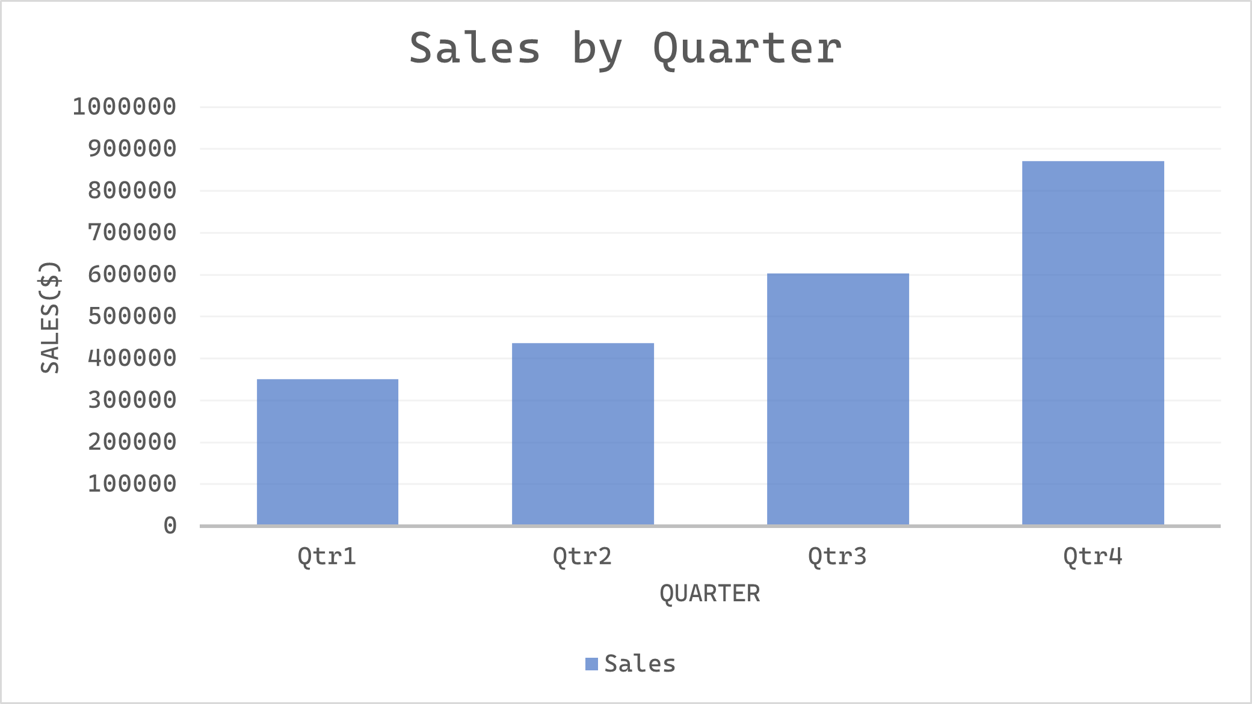
Q4 sees 150% increase in sales from Q1

Slide 6
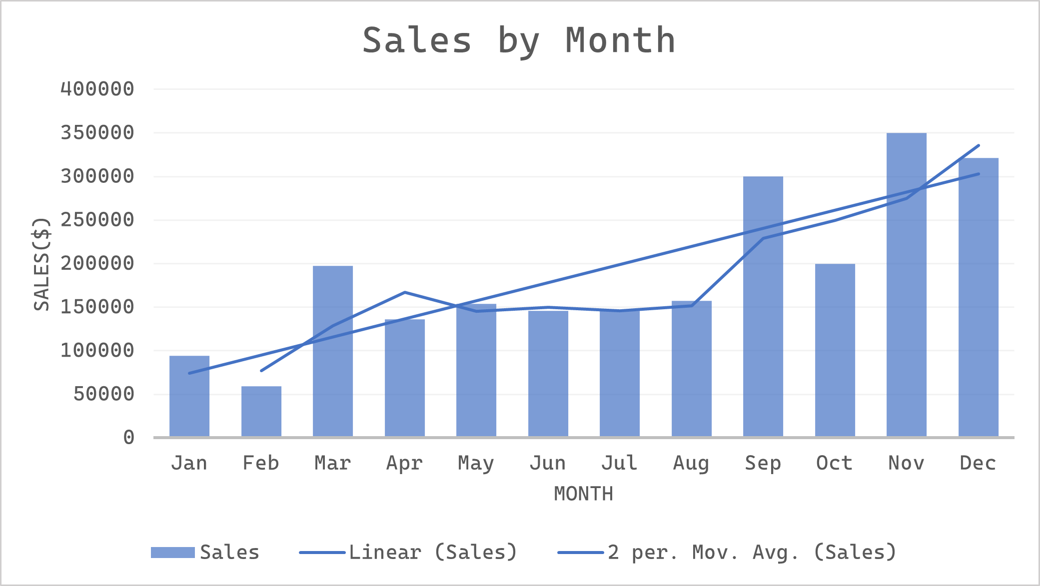
November, highest revenue generating month

Slide 7
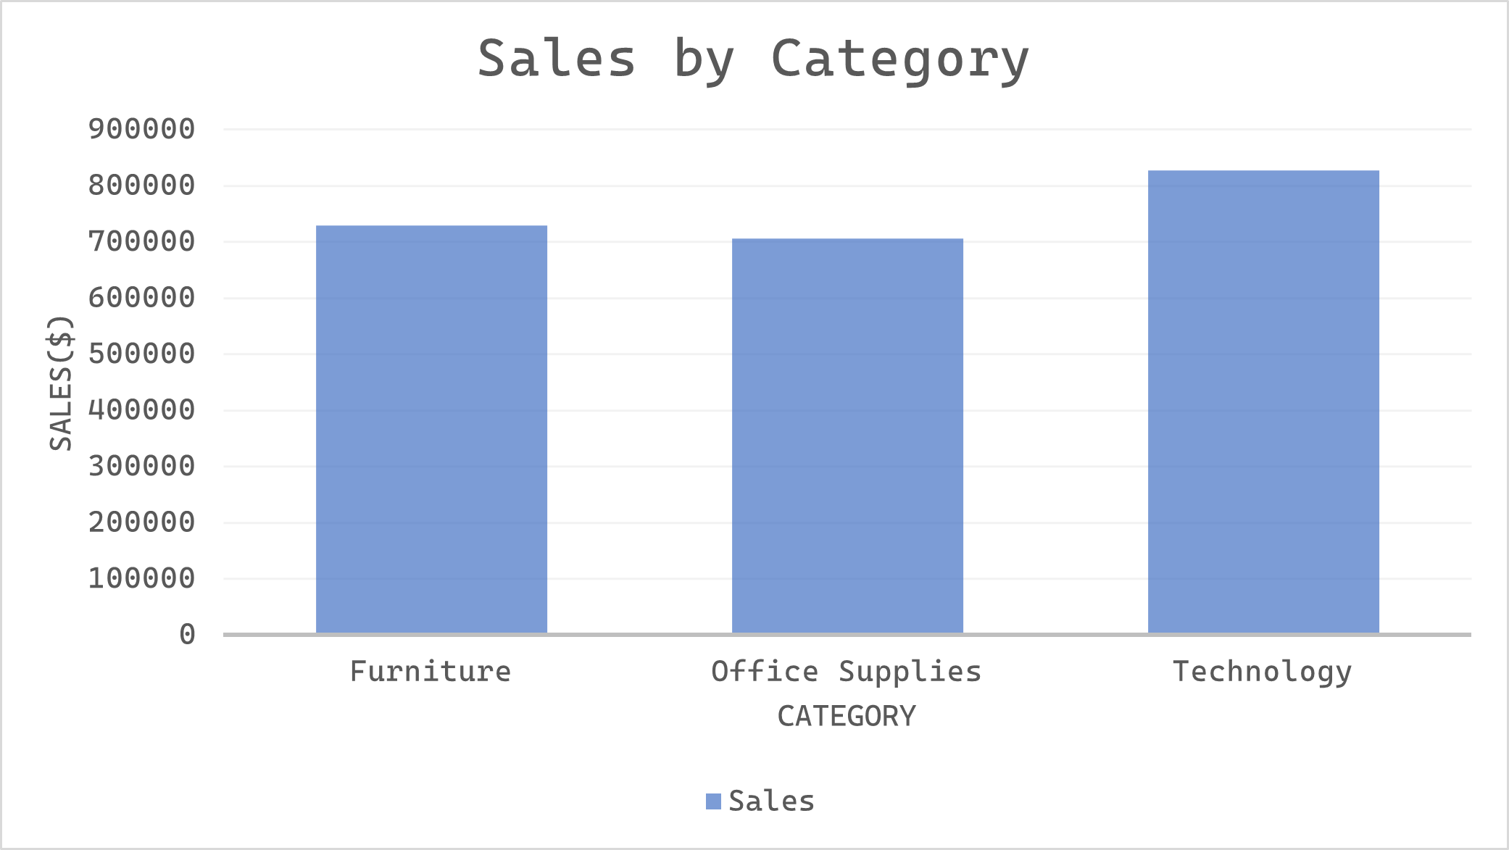
Technology generated 13% more revenue than Furniture

Slide 8
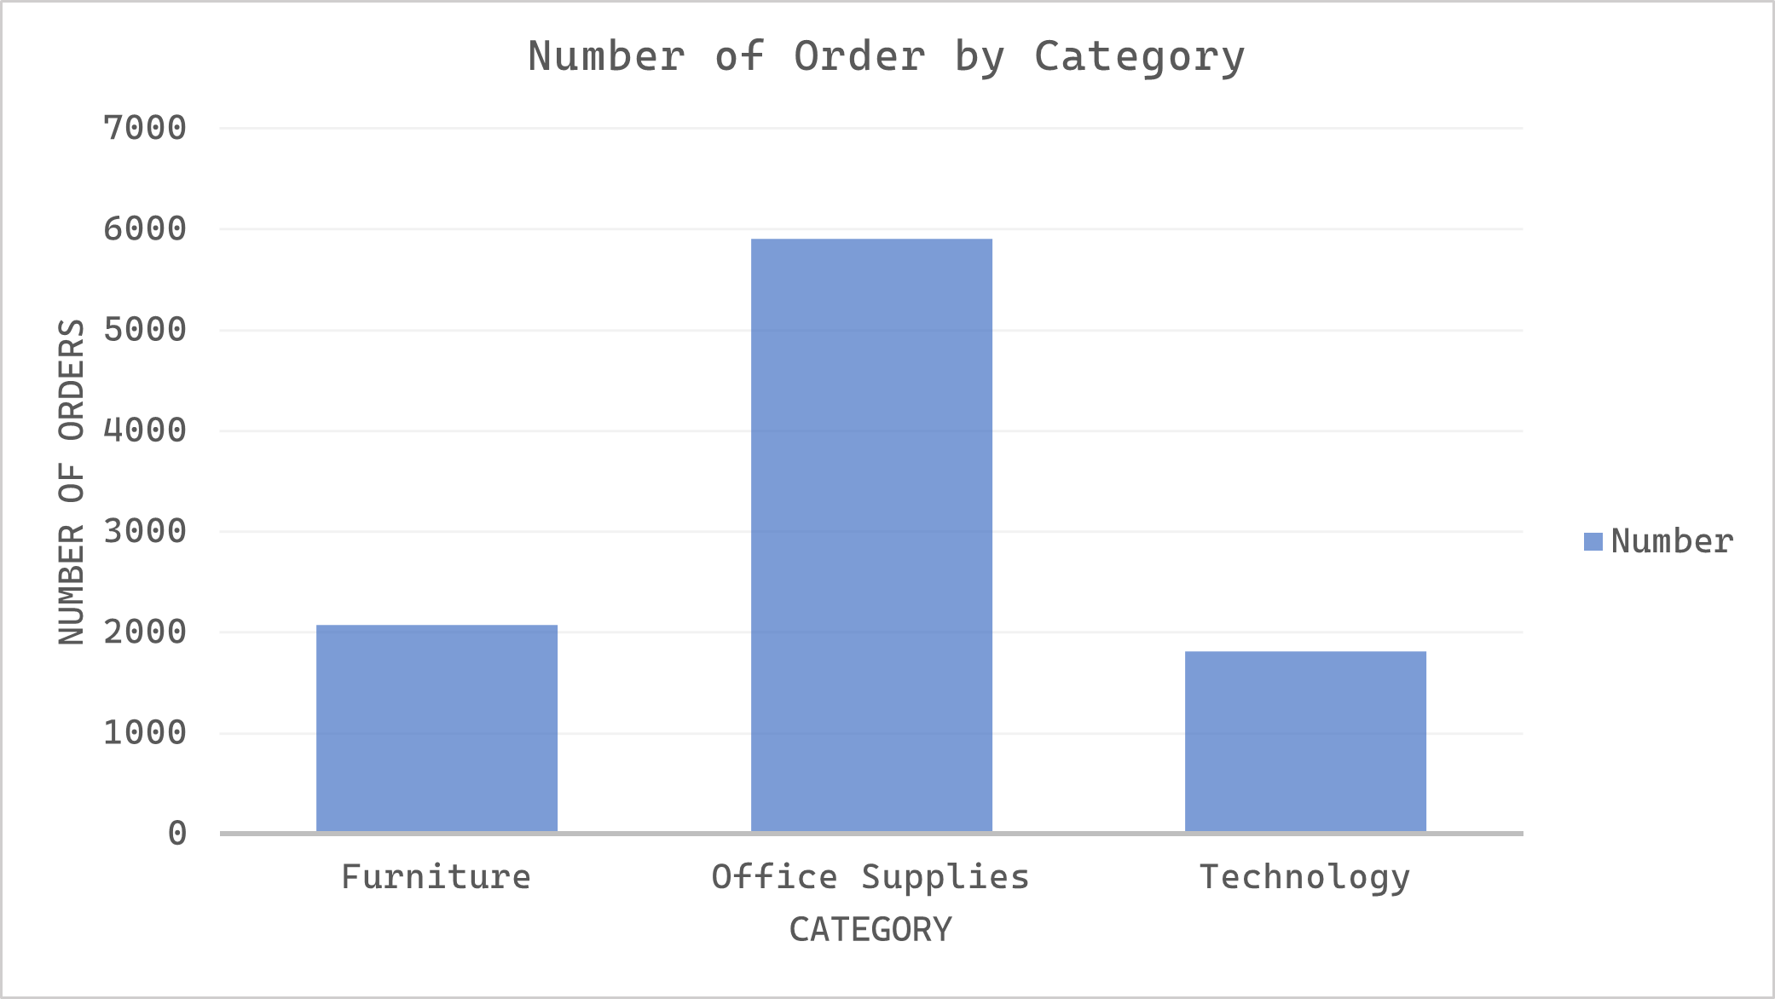
Office Supplies dominates by 6000+ orders

Slide 9
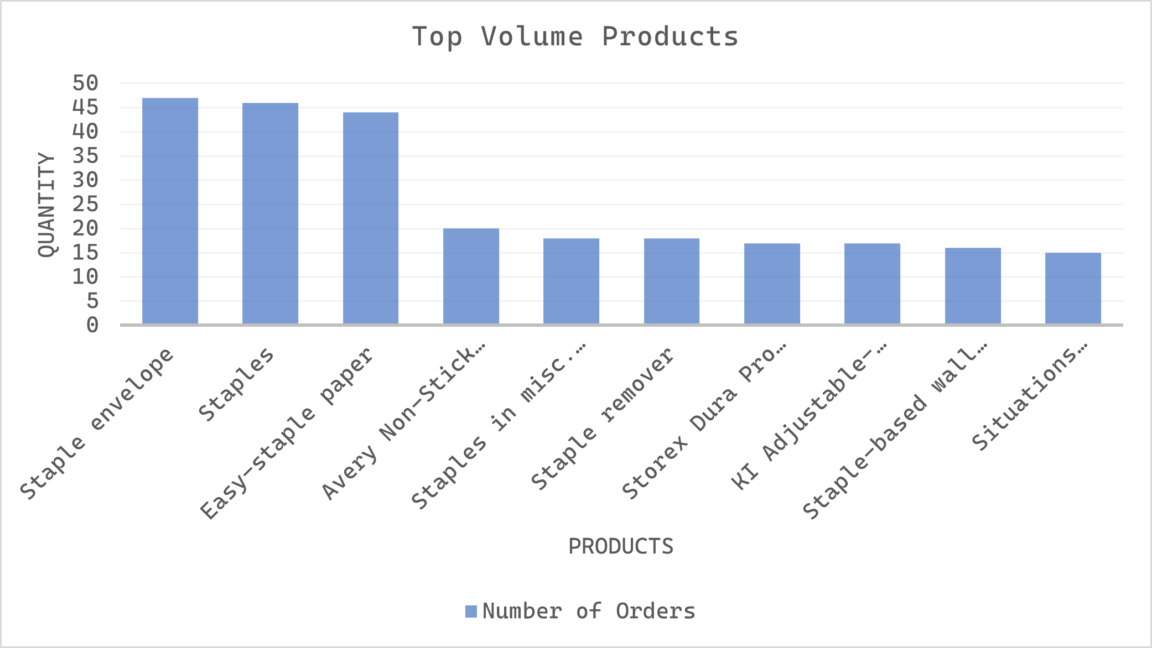
Staple, Paper and Binder drive the maximum volume

Slide 10
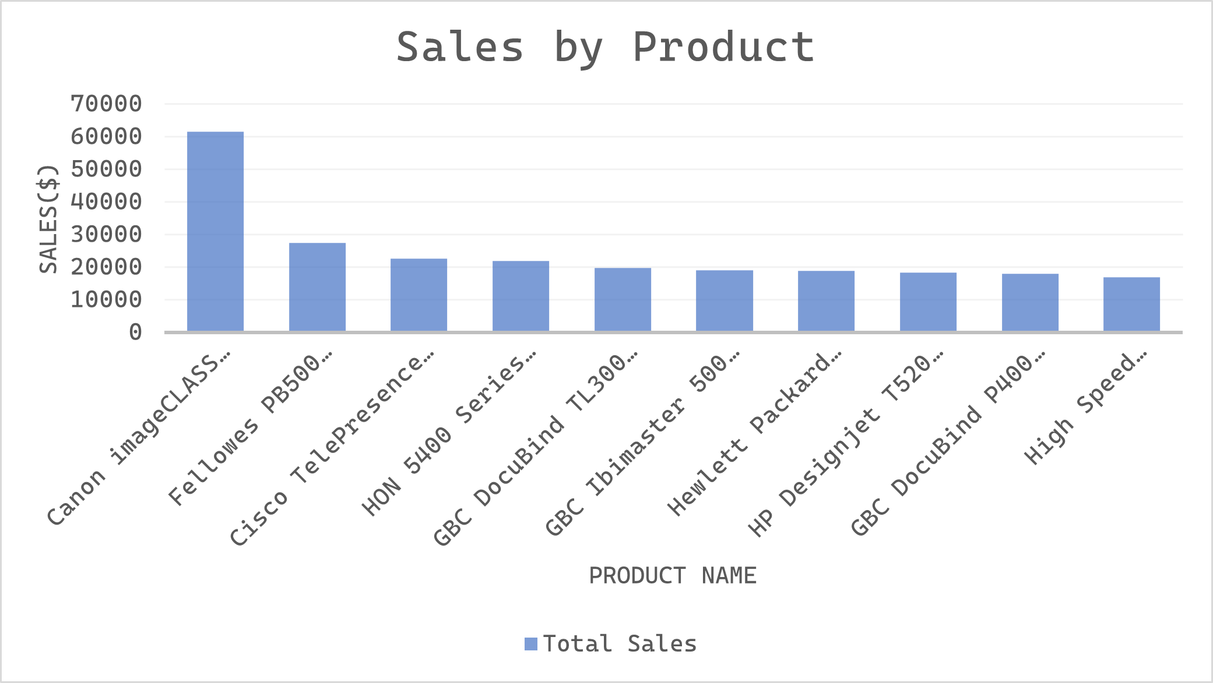
Canon Copier leads revenue at $61k revenue

Slide 11
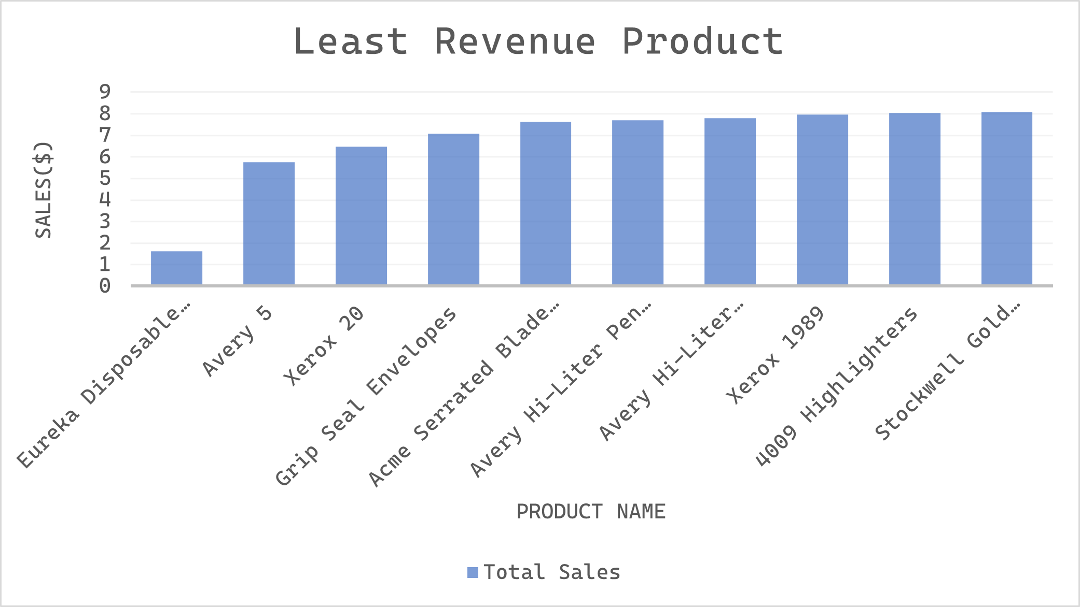
Eureka Disposable, the least sold product

Slide 12
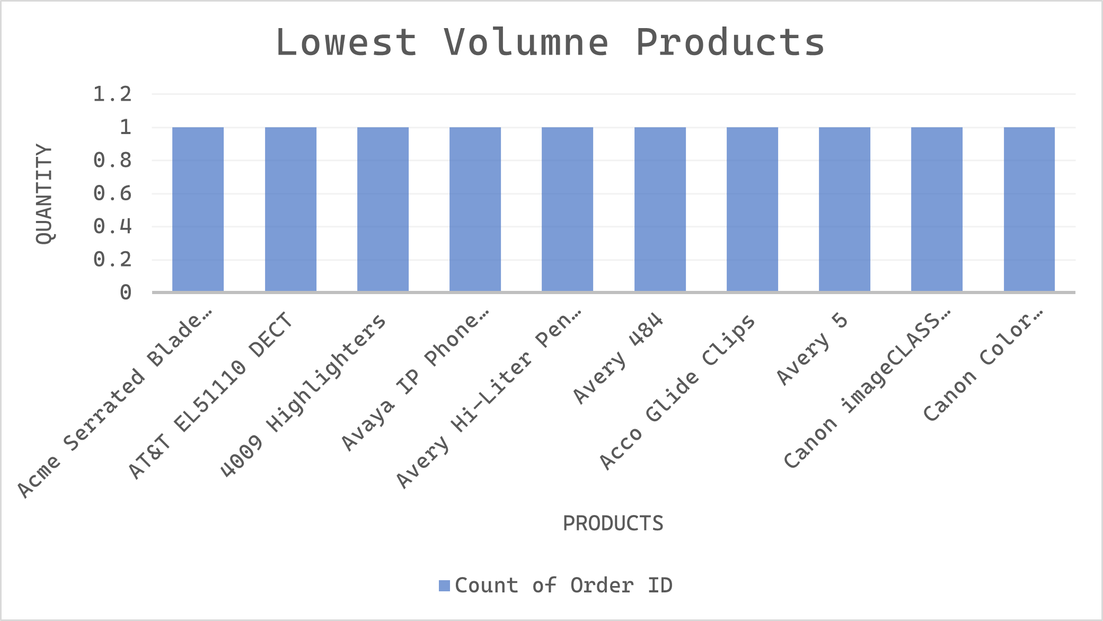
Volume sold plummeting to 1 of 94 products

Slide 13
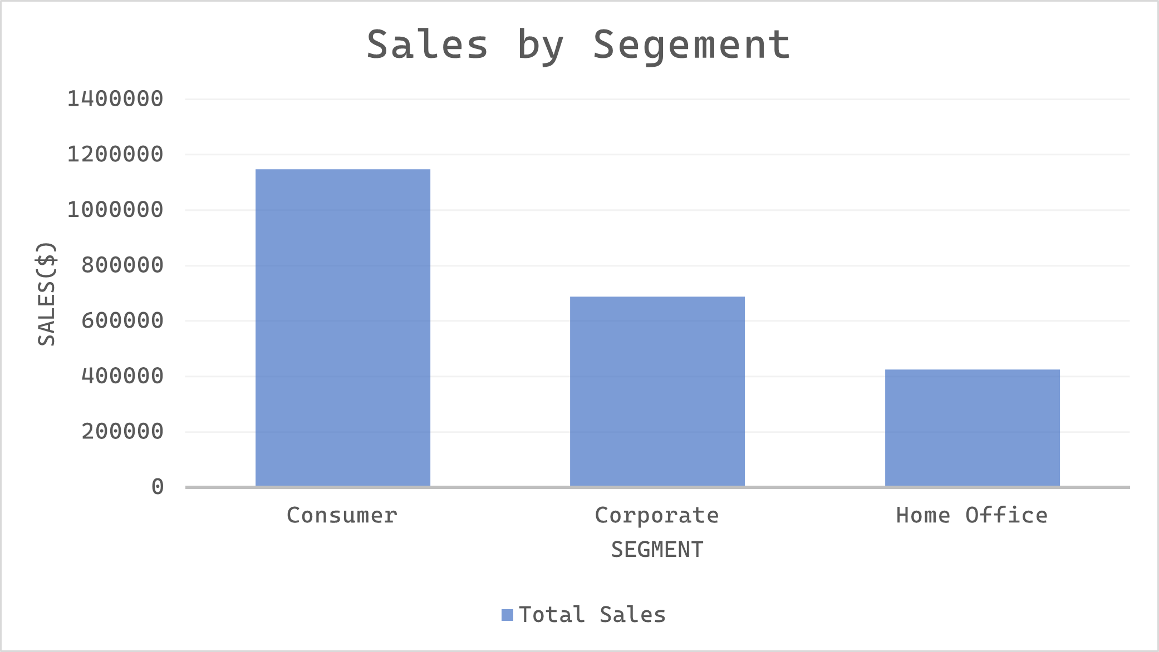
Consumer segment accounts for 50%+ of all sales

Slide 14
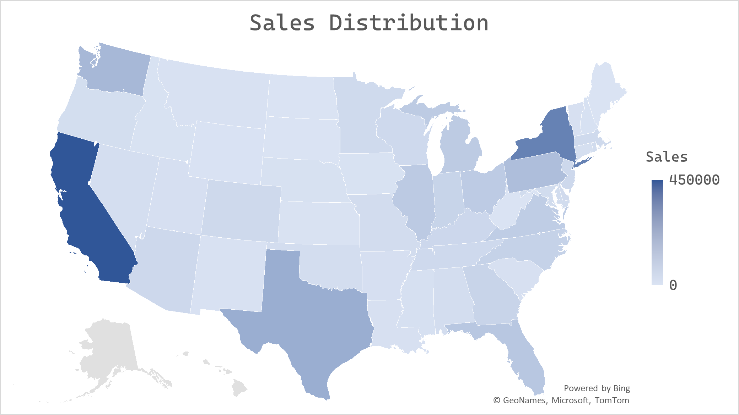
West leads the sales, Central shows growth potential

Slide 15
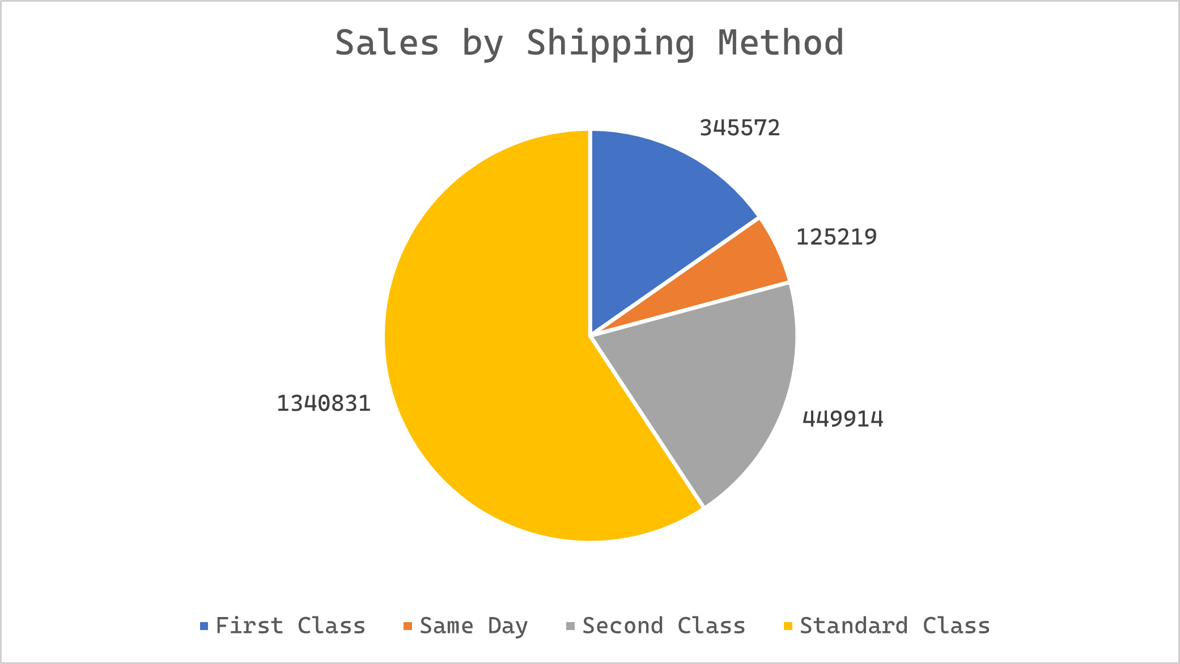
Standards Class shipping preferred by 50%+ customers

Slide 16
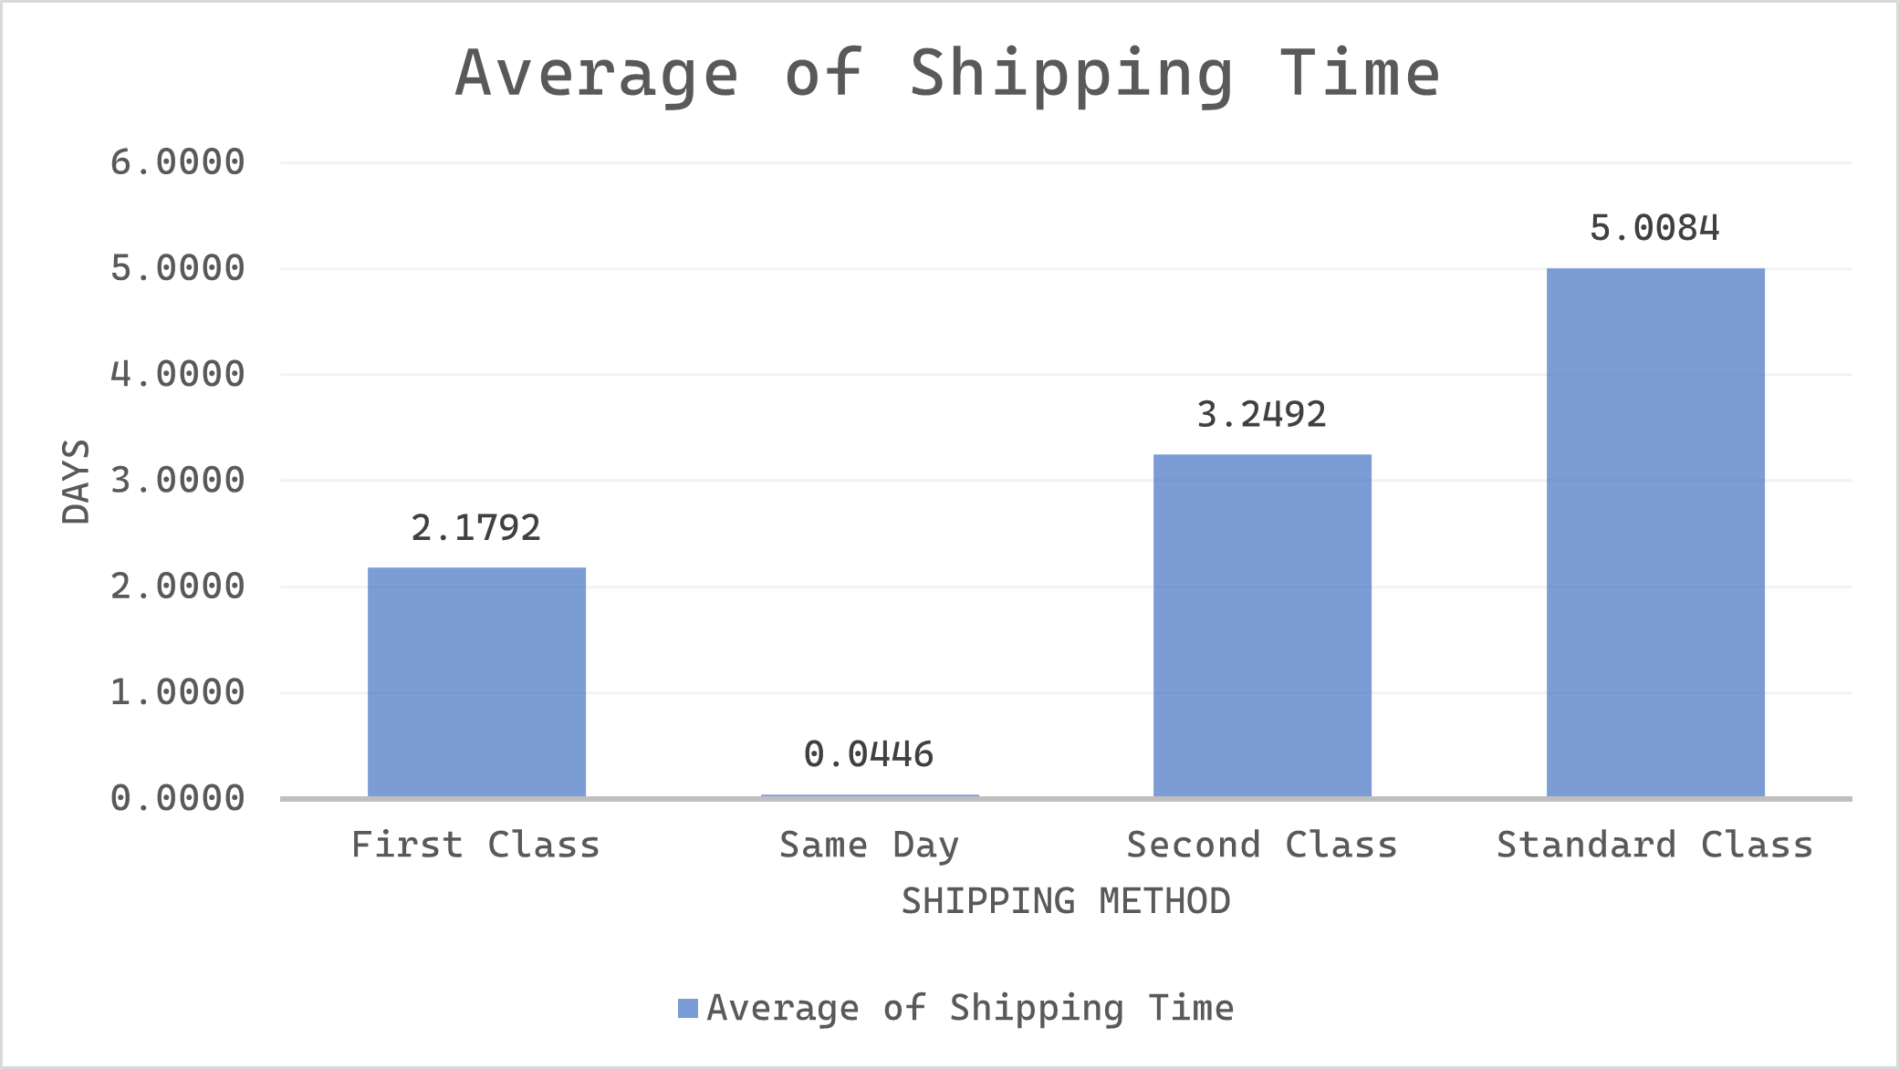
Standard Class shipping taking full work-week

Slide 17
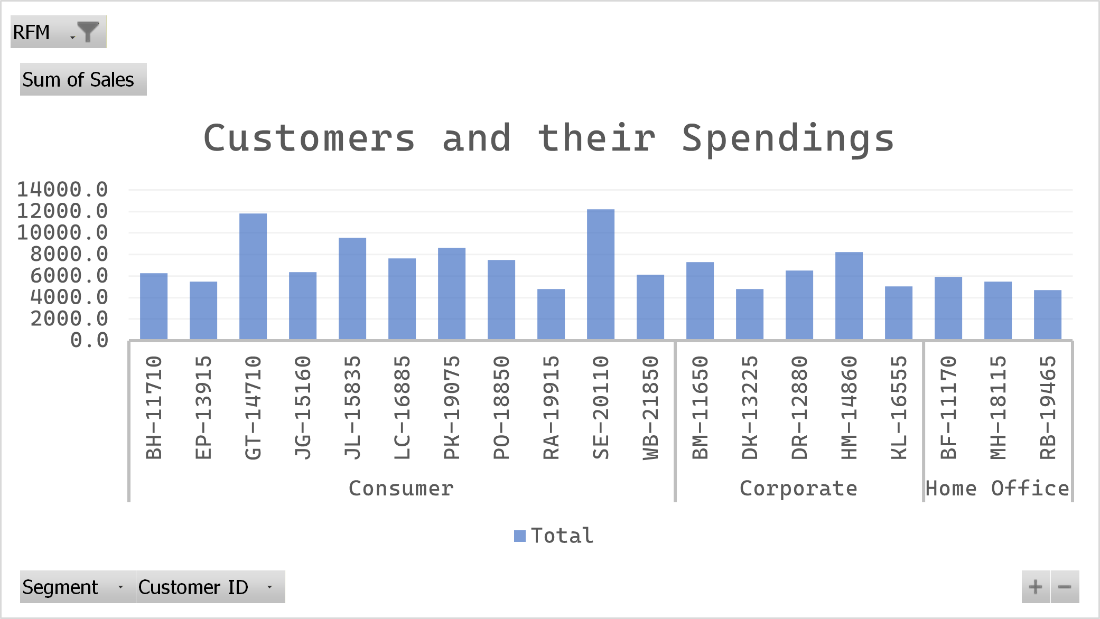
Best customers are consumer majority(by RFM analysis)

Slide 18
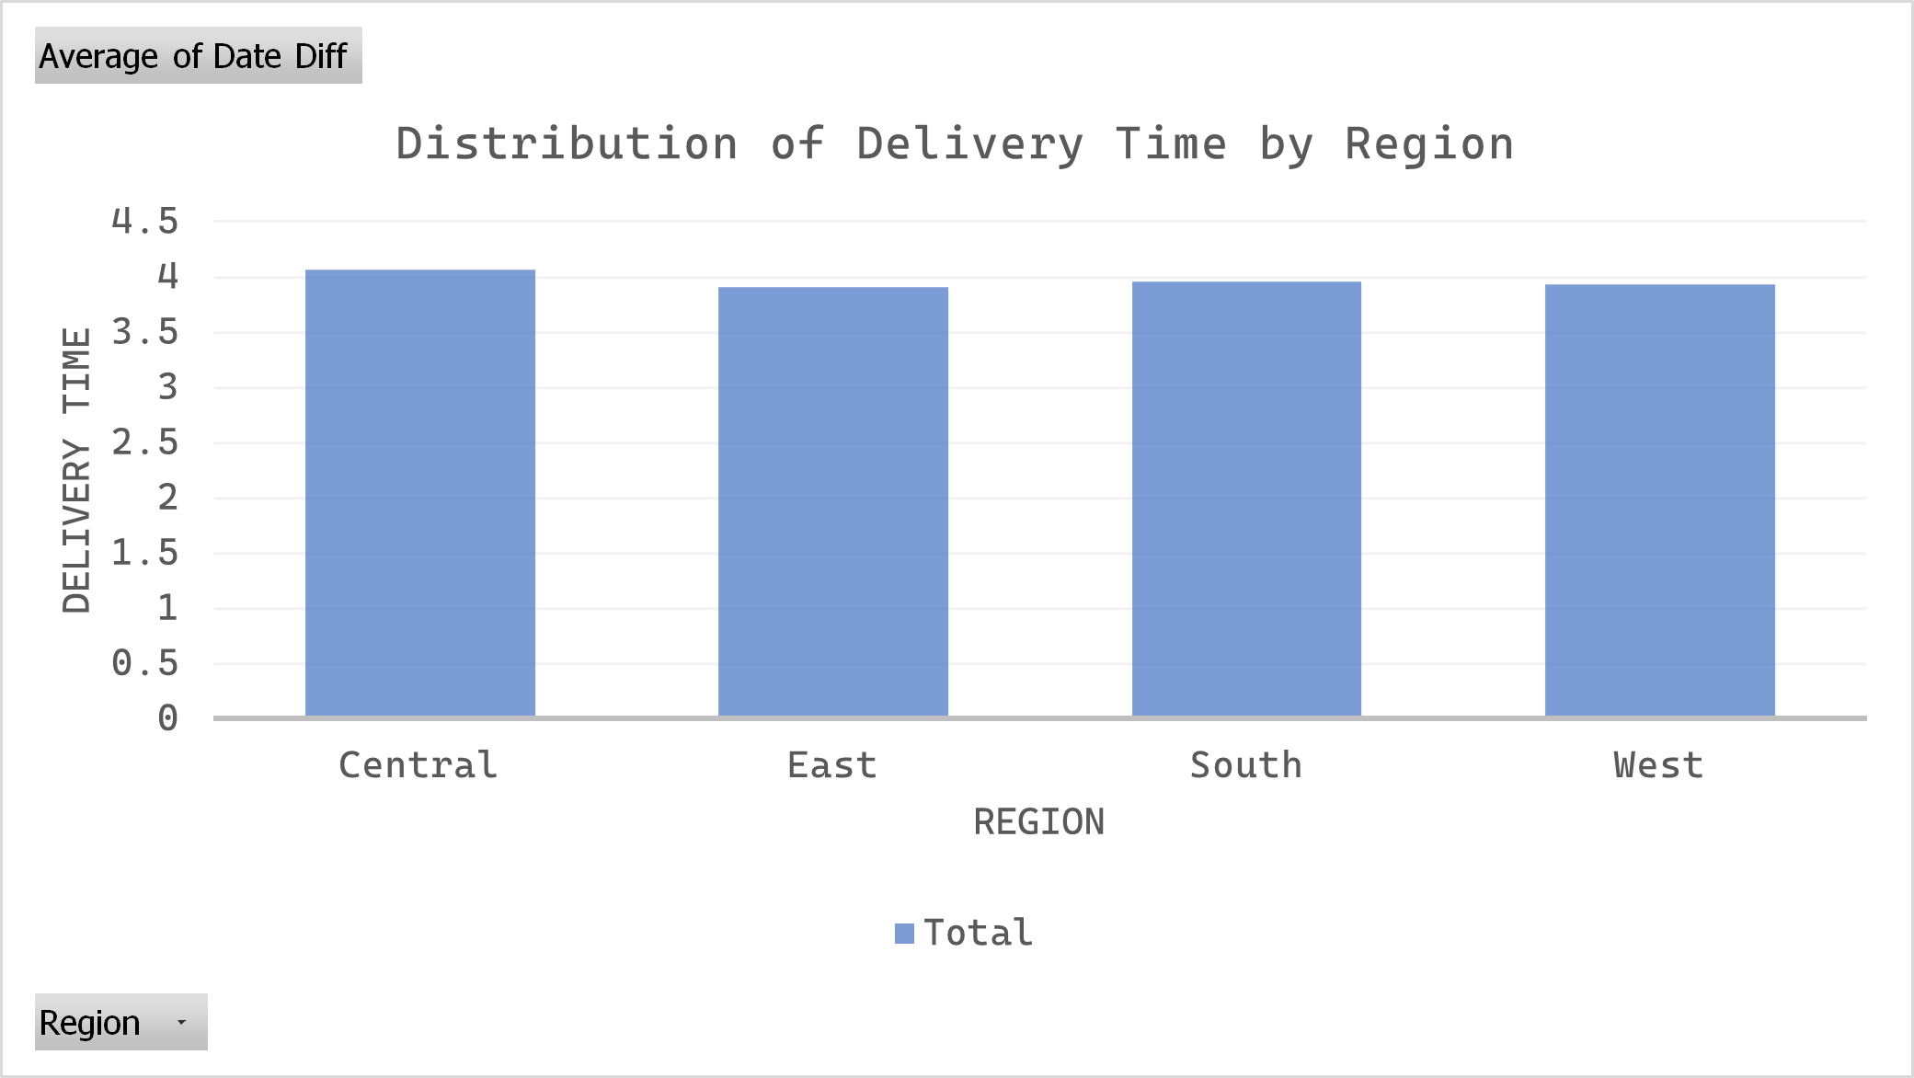
Delivery Times taking 4 working days

Slide 19
Recommendation
More products for the Consumer segment as they account for 50% of the sales.
Increase the number of employees as well as inventory during the last quarters as the sales as well as the number of purchases increases during that time.
Focus more on the East and Central for new customers. Work on the delivery time in the Central.
Research on the one day delivery option, as maintaining it is costly, hence removing it increase profit, but might effect some consumers.

Slide 20
Next Step
Optimize the Q3 and Q4 inventory by 50% more of the most selling products, based on the historical data.
Review Same Day delivery economics, which is only used by 0.42% of the total customer base.
Analyze underperforming region with growth potential.
Launch a retention campaign for top 127 “Best” customers identified through RFM analysis.
Price optimization study, test pricing elasticity in the Technology category.

Slide 21
Thank you

